Slide 1
Some(what) Grand Challenges for Information Retrieval
Nicholas J. Belkin
Venue: SIGIR FORUM’08
Personalized Social Search Based on the User’s Social Network
Carmel, Zwerdling, Guy, Ofek-Koifman, Har’el,
Ronen, Uziel, Yogev and Chernov
Venue: CIKM’09

Slide 2
Challenge for IR Research
“Substantial progress in information retrieval was likely only to come through addressing issues associated with users of IR systems, rather than continuing IR research’s almost exclusive focus on document representation and matching and ranking techniques.” by Karen Sparck in 1998 on receiving SIGIR Gerrard Salton Award

Slide 3
Information-related goals, tasks and intentions
Ability to characterize and differentiate among information-related goals, tasks and intentions
Infer information-related goals, intentions and tasks from previous or concurrent behavior
IR techniques that effectively respond to them

Slide 4
Understanding and supporting information behavior other than specified search
Ability to identify or understand the situations which lead to any one information behavior or a sequence of behaviors
Evaluation of systems that support different information behavior

Slide 5
Characterizing Context
Theories and classifications which tell us about features that affect information behavior
IR systems that identify the features and use them
Evaluation measure to compare the effects of features

Slide 6
Taking account of affect
Emotions which people experience during interaction with information, whether in an IR system or not, can substantially affect how such interaction proceeds, and how subsequent interactions might take place.
Making IR pleasurable (Obvious solution)
Identify the significance of the issue
Design IR techniques to reduce the occurrence of undesirable experiences

Slide 7
Personalization
Identify the dimensions along which personalization could or should take place
Identify the factors and their interactions in the personalization
Devise techniques to take into account all the factors to build a personalized experience

Slide 8
Integration of IR in the task environment
Arrange things such that a person never has to engage in interactions with a separate IR system at all
Effective integration of IR system in task environment

Slide 9
Evaluation paradigms for interactive IR
Difference in the qualitative analysis of search from the sheer quantitative difference
Establishment of standards for collection in data for interactive IR experiments

Slide 10
(In)Formal models of interactive IR
Most of the models does not have any place for the user, nor for interaction.
Concerned with issues of representations of information objects and given, static queries, and of matching and ranking techniques.

Slide 11
Conclusion of the Paper
IR models which treat user as active participant in the IR system
IR models with user interaction with information as a central process

Slide 12
Why the Second Paper Cites the First Paper
Builds on the suggestions provided for studying personalization problem
Identifies a new dimension to study personalization
Evaluates different factors in the dimension to build a personalized search

Slide 13
Personalization of Search Results
Investigates personalized social search based on user’s social relations
Search results are re-ranked according to the relation with individuals in the user’s social network
Study effectiveness of various social network for personalization and compare with topic-based personalization

Slide 14
Social Network Types for Personalization
Familiarity-based Social Networks
Similarity-based Social Networks
Overall Social Networks

Slide 15



Familiarity-based Social Networks
Direct Familiarity
Author of
Author of
Indirect Familiarity
A
B

Slide 16
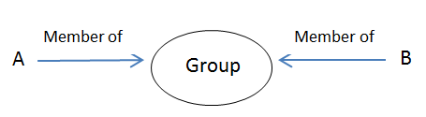

Similarity-based Social Networks

Slide 17
Overall Social Networks
Both Familiarity Social Networks and Similarity Social Networks used

Slide 18
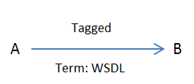
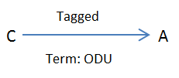
Topic-Based
Topics of interest for user A: WSDL and ODU

Slide 19
Off-Line Experiment
Used IBM’s Lotus Connections (LC) which has profile of all employees, a social bookmarking system, a blogging service, a communities service and activities
Used Social Networks and Discovery (SaND) an aggregation tool over social data gathered from LC for information discovery and analysis

Slide 20
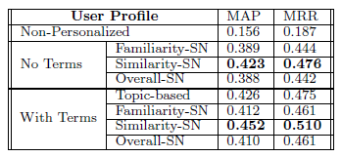
Results of Off-Line Experiment
All personalization techniques outperform non-personalized search
Similarity-SN outperforms Familiarity and Overall-SN
Topic-based search with no SN data performs better than Familiarity
and Overall-SN

Slide 21
User Survey
Organization wide survey conducted
Users with at least 30 people in similarity and familiarity list were considered
Over 240 users from 28 countries participated on 577 personal queries

Slide 22
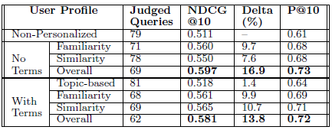
User Survey Experiment
All personalized strategies outperform non-personalized search except for
Topic-based search
Maximum improvement was achieved by Overall-SN
Similarity-SN outperforms Familiarity-SN and Topic-based search
Related terms improve performance except for Overall-SN

Slide 23
Results of the Paper
Social network based personalization outperforms non-personalized social search
Social activity of similar people better predict the user’s social activity than the activity of familiar people
Discrepancy in offline test and user survey can help in parameter tuning for personalization search strategies

